Slide 1
Technical Session 2 [Draft] IFRS S1 General Requirements for Disclosure of Sustainability-related Financial Information
Technical Session 2
Siobhan Hammond (Australian Accounting Standards Board)

Slide 2
Purpose of this session
To provide an overview of:
the key themes from the AOSSG submission to the International Sustainability Standards Board’s (ISSB) General Requirements Exposure Draft; and
The ISSB’s preliminary response to address similar feedback on related themes

Slide 3
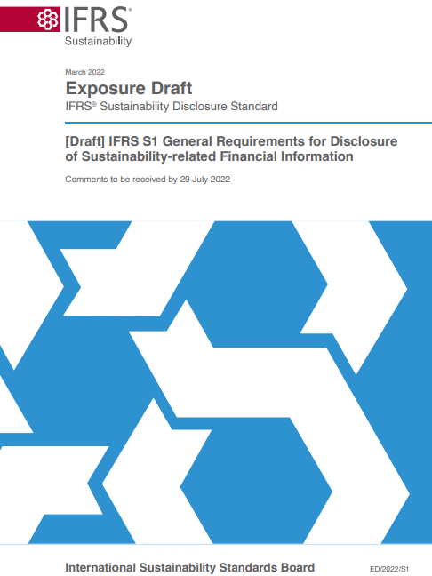
Overview of [Draft] IFRS S1
Requires entities to disclose material information on all significant sustainability-related risks and opportunities necessary to assess enterprise value.
Other ISSB standards will set out specific disclosure requirements
Makes reference to a hierarchy of other standards and frameworks to be applied in the absence of an ISSB standard:
SASB Standards are priority, followed by the CDSB Framework and Guidance and then any jurisdictional initiatives

Slide 4
Key theme of feedback—Definitions
[Draft] IFRS S1 acts as both a conceptual framework and standard addressing general disclosure requirements and seeks to define common concepts and terms
However, some terms were not defined (for example, sustainability and significant) and some require further clarity to ensure consistent application (for example, enterprise value and material sustainability-related financial information)
Recommendation
AOSSG members recommended that the ISSB:
Define commonly used terms such as sustainability and significant; and
Provide additional guidance to support consistent application of major concepts and definitions such as enterprise value and the definition of material.

Slide 5
Definitions – ISSB preliminary response
While project redeliberations are still ongoing, the ISSB has made the following tentative decisions related to definitions:*
Enterprise value
Remove the definition from Appendix A to [Draft] IFRS S1
Remove the words ‘assess enterprise value’ from the objective and definition of material in [Draft] IFRS S1
Draw on existing frameworks to more clearly articulate the concept of enterprise value and its link with sustainability-related financial reporting
Significant
Remove the term ‘significant’ and the phrase ‘all significant’ in relation to sustainability-related risks and opportunities
*Refer to the October 2022 ISSB Update

Slide 6
Key theme of feedback—Boundary of reporting
AOSSG members expressed concern about the boundary of reporting when applying the value chain concept. For example, the proposals are not clear on what information should be considered as part of an entity’s value chain
Recommendation
AOSSG members recommended that the ISSB:
Clarify what the boundary of reporting is when applying the value chain concept; and
Develop additional guidance to support the application of the definition of material.

Slide 7
Boundary of reporting – ISSB preliminary response
While project redeliberations are still ongoing, the ISSB has made the following tentative decisions related to the boundary of reporting:*
Value chain
Make no changes to the definition or substance of the requirements related to value chain or the reporting entity
To develop guidance, or further emphasise existing guidance, on how entities should approach reporting on subsidiary and value chain activities
*Refer to the October 2022 ISSB Update

Slide 8
Key theme of feedback—Scalability
Some AOSSG members said that, given the complexity of the proposals, IFRS Sustainability Disclosure Standards will be highly challenging to implement in emerging economies and for small-to-medium sized entities (SMEs)
Recommendation
AOSSG members recommended that the ISSB better consider the proportionality and scalability in its future standard-setting activities and as part of its redeliberation of the proposals.

Slide 9
Scalability – ISSB preliminary response
While project redeliberations are still ongoing, the ISSB has made the following tentative decisions related to the scalability of IFRS Sustainability Disclosure Standards:*
Scalability
The ISSB tentatively decided on the following factors to assess which scalability mechanisms are appropriate for responding to specific scalability challenges:
Whether the scalability challenges are temporary (in other words transitional) or more permanent (for example, due to data availability)
The extent to which the set of entities with a scalability challenge can be specifically identified
The extent of available market guidance, methods, industry-practices and techniques
The maturity of the underlying methods and techniques that underpin the disclosure requirement
*Refer to the September 2022 ISSB Update

Slide 10
Key theme of feedback—Connected information
AOSSG members noted that while the need for connectivity is clear, the proposals lack clarity on the practical application of the related requirements
For example, AOSSG members questioned where and how should an entity provide connected information between its sustainability-related financial disclosures and general purpose financial statements?
Recommendation
AOSSG members recommended that the ISSB :
Develop additional explanation, guidance and illustrative examples to support the proposals related to connected information; and
Develop additional guidance to support the application of the definition of material.

Slide 11
Key theme of feedback—Sources of guidance
[Draft] IFRS S1 refers to a hierarchy of other standards and frameworks to be applied in the absence of an IFRS Sustainability Disclosures Standard (for example, SASB Standards, the CDSB Framework and jurisdictional initiatives)
AOSSG members observed that:
The proposals in paragraph 51 are too broad and may result in practical challenges
It is not clear whether the proposals in paragraph 51 are mandatory requirements or voluntary guidance
Recommendation
AOSSG members recommended that the ISSB clarify that proposed paragraph 51 is voluntary guidance and not a mandatory requirement.

Slide 12
Question for AOSSG members
Do AOSSG members have any comments or feedback on the information in these slides?

